Slide 1

Locate bottom of controller at 42” H to be ADA Compliant; alternate height option is 45”
Individual Locker Choices – mix & match to build out frames
You can “mix and match” various lockers on these pages using the 6 ft. frames or 3 ft. frames on the Locker Worksheet pages.
714-056 Touchscreen Controller
12” H x 24” W
714-206 – 1 18” Door & 1 6” Door
both 12” H
714-212 – 2 Door 12” Wide
X 18” H
A
B
714-101 – 1 Drawer, 3” H
A
B
714-210 – 4 Door, 36” H x 6” W
714-102 – 1 Drawer, 6” H
A
B
C
D
714-207 – 1 Door, 12” H
714-213 – 1 12” Door & 2 6” Doors all 6” H
A
714-103 – 2 Drawer, 3” H
B
A
B
C
714-104 – 1 Drawer, 4.5” H Military
714-201 – 4 Door, 6” H x 6” W
714-214 – 1 18” Door & 1 6” Door
both 18” H
A
B
C
D
714-208 – 1 Door, 18” H
A
714-202 – 2 Door, 6” H x 12” W
B
A
B
714-203 – 1 18” Door & 1 6” Door both 6” H
A
B
714-216 – 4 Door, 12” H
x 6” W
714-217 – 1 Door, 36” H x 24” W
714-204 – 1 Door, 6” H
A
B
C
D
714-209 – 1 Door, 24” H
714-218 – 3 Door, 12” H
x 8” W
A
714-205 – 2 Door, 12” H
x 12” W
B
A
B
C

Slide 2
Individual Locker Choices – Cont.
714-224 – 4 Door, 18” H
x 6” W
A
B
C
D
714-229 – 3 Door, 18” H
x 8” W
A
B
C
714-236 – 3 Door, 8” W x 6” H

Slide 3
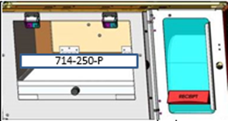
Locker Modules (cont.)
(cont)
= Power
714-051 SuperRobo Controller
714-052 – Network Switch Enclosure
1 Door, 6” H
614-006 – Front Vanity Panel, 3” H
614-036 – Front Vanity Panel, 9” H

Slide 4
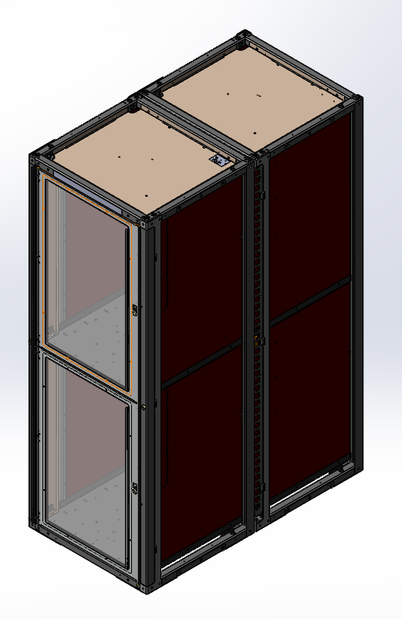
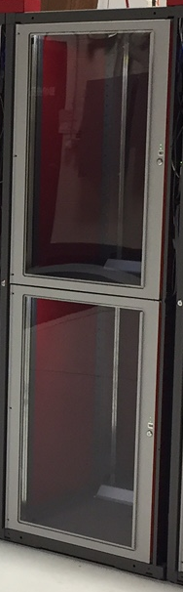
Locker Modules (cont.)
714-219
6 ft. Double-Deep Frame
Good for tires & bulky objects
A
714-219 – 2 Door Tire Locker,
36” H x 24” W X 48” Deep
(Includes 2 frames)
714-211 – 2 Door, 72” H x 12” W
714-215 – 1 Door, 72” H x 24” W
A
B
B

Slide 5
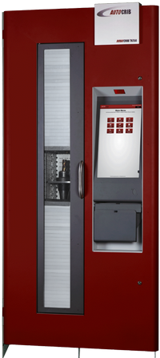
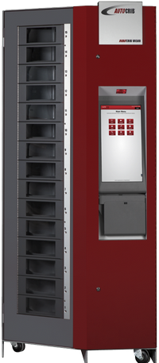
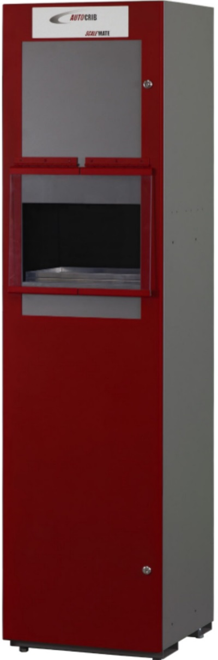
AutoLocker FX Configurations
you can use the AutoLocker FX as a stand-alone configuration with its own touch-screen controller (#714-056), or attach it as an auxiliary unit to the standard RoboCrib VX or LX Models, or the RoboCrib TX750 using the CBI Controller (#714-051)
The ScaleMate accessory can also be attached to any RoboCrib model
RoboCrib TX750
RoboCrib VX or LX
ScaleMate

Slide 6
Additional Worksheet
you can “mix and match” various lockers to fit in either the 6 ft. frame or 3 ft. frame models, in any combination. If you want more worksheets to build alternatives, copy this slide blank before inserting lockers
714-001-PL
6 ft. Frame
714-001-PL
6 ft. Frame
714-001-PL
6 ft. Frame
714-003-PL
3 ft. Frame

